Slide 1
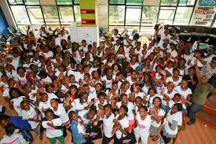
AKIRACHIX MORE OF NEW CHICKS
Ready minds to learn
Well trained students
Positive learning attitude

Slide 2
JOINING THE BREAKFAST
Was welcomed by happy students. Well served breakfast.
Was angry on my arrival but I was sorted out in by welcoming food

Slide 3
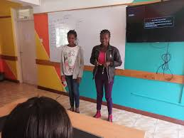
LEARNING MORE ABOUT OTHERS
Each moment of learning in class
Game and sports
The way food is organized to all students
Accepting others and their culture

Slide 4
FIRST DAY IN THE CLASSROOM
Introduction to computer to was challenging but I appreciate Rachael she was the fist student and other friends .But am catching up with my fellow students

Slide 5
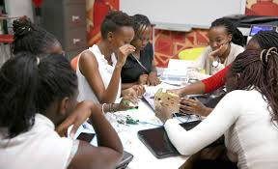
EXCITING MOMENTS
Up coming bright engineers
Community changer zone

Slide 6
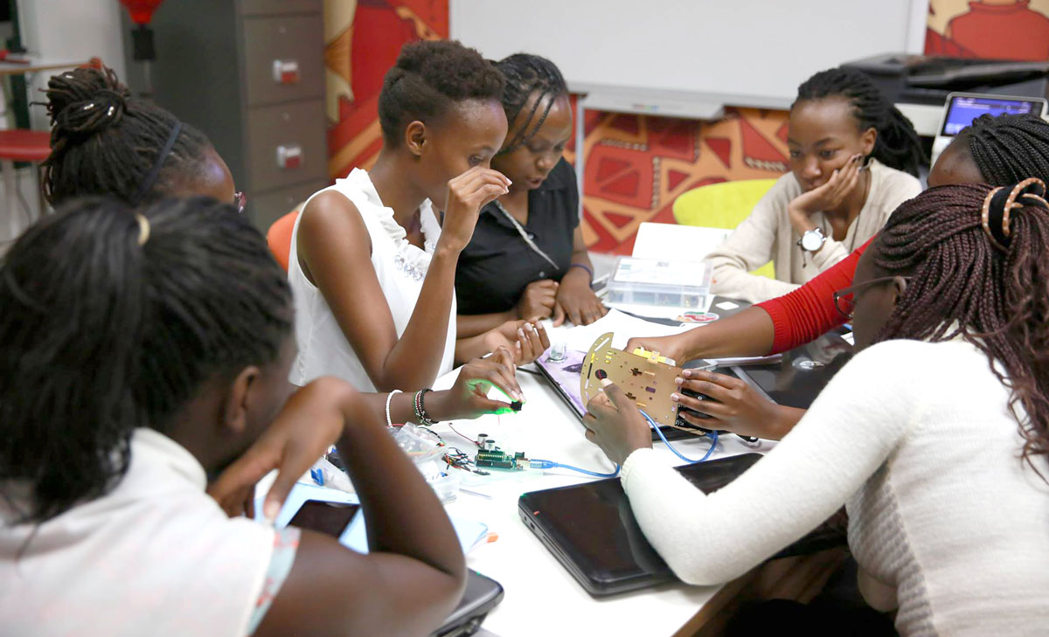
INSPIRATION FROM THE FIRST GRADUANTS

